Slide 1
LIPASE
Enzymatic Processes in Industrial Production: Lipase in Biodiesel Production
Biology for Engineers
Unit 1: Biomolecules and Enzymes
Presented by: Jaskaran Singh Sethi
Division: D
Roll No: 15

Slide 2
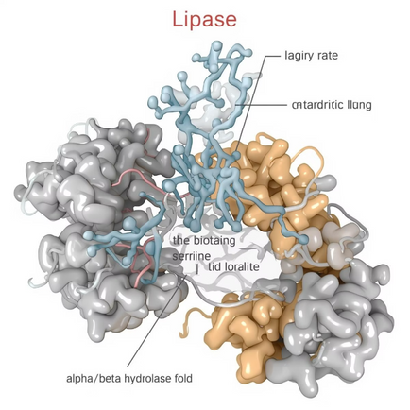
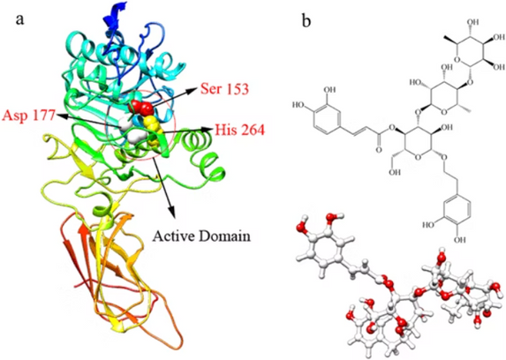
Introduction to Lipase
Lipases are enzymes, essential biological catalysts playing a critical role in the hydrolysis of fats (lipids) into their constituent fatty acids and glycerol. This fundamental biochemical reaction is vital for nutrient absorption and metabolism in living organisms.
Occurrence
Lipases are widely distributed in nature, found in a diverse array of organisms:
Microorganisms: Bacteria, yeasts, and fungi are prolific producers of lipases, making them a primary source for industrial applications.
Plants: Found in various seeds, where they aid in the mobilization of stored lipids during germination.
Animals: Crucial for digestion, with pancreatic lipase being a prime example in humans, breaking down dietary fats.
For industrial applications, microbial lipases are particularly favored. Their robust nature, broad substrate specificity, and ease of production via fermentation make them ideal candidates for large-scale processes.

Slide 3
Key Properties for Industrial Utility
The characteristics of lipases make them highly valuable in various industrial sectors:
Mild Reaction Conditions: Unlike many industrial chemical processes that require harsh temperatures, pressures, or extreme pH, lipases operate optimally at mild temperatures (typically 30-50°C) and neutral pH (around 7-8). This reduces energy consumption and minimizes side reactions.
Reusability via Immobilization: To enhance their stability, activity, and facilitate easy separation from the reaction mixture, lipases can be immobilized onto inert carriers. This process allows for repeated use, significantly reducing enzyme costs in continuous production systems.
Functional in Organic Solvents: A unique advantage of many lipases is their ability to maintain catalytic activity in non-aqueous environments. This is crucial for reactions involving hydrophobic substrates, such as transesterification, which often occur in organic solvents, expanding their applicability in diverse chemical synthesis pathways.

Slide 4
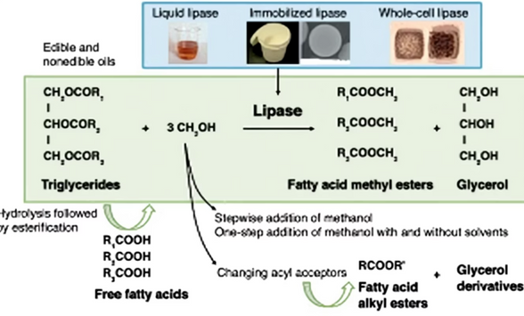
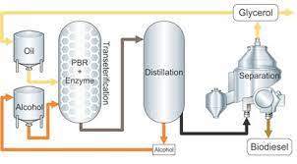
Lipase-Catalyzed Biodiesel Production: A Greener Path to Fuel
Traditionally, harsh chemical processes are used to produce biodiesel, a renewable substitute for petroleum diesel. However, through a process known as transesterification, lipase enzymes provide an effective and environmentally friendly path.
The Enzymatic Transformation
The core of lipase-catalyzed biodiesel production lies in the transesterification reaction:
Enzyme: Lipases derived from microbes such as Candida antarctica lipase B (CALB) are very efficient.
Substrates: The primary raw materials are triglycerides, which are the main components of vegetable oils (e.g., soybean, canola, palm oil) or animal fats.
Conversion: Fatty Acid Alkyl Esters (FAAEs), also referred to as Biodiesel (or Fatty Acid Methyl Esters, or FAMEs when methanol is used), are created when lipase helps move fatty acyl groups from triglycerides to the alcohol.
Reactant: An alcohol, typically methanol or ethanol, is used to react with the triglycerides.
Byproduct: Glycerol is produced as a valuable byproduct, which can be further refined and used in various industries, including pharmaceuticals and cosmetics.

Slide 5
Conditions For The Reaction To Take Place
Optimized Reaction Conditions
The advantages of enzymatic biodiesel production is the mild reaction conditions required, contributing to its "green" credentials:
Temperature: The process typically occurs at moderate temperatures, ranging from 35–45°C. This is significantly lower than the high temperatures (often >60°C) required for chemical catalysis, leading to reduced energy consumption and preventing thermal degradation of reactants or products.
pH: A near-neutral pH environment (7–8) is ideal for lipase activity, eliminating the need for strong acids or bases that are corrosive and require careful handling and neutralization.
Eco-friendly & Solvent-Free: Many enzymatic processes can be designed as solvent-free systems, further reducing environmental impact and simplifying downstream processing. This inherent eco-friendliness makes lipase-catalyzed biodiesel an attractive option for sustainable fuel production.

Slide 6
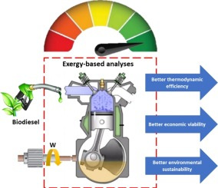

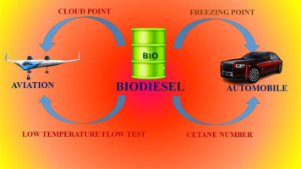
Final Product Biodiesel Sustainable Energy Solution
Biodiesel, derived from renewable sources, represents a crucial step towards a more sustainable energy future.
The primary product of the lipase-catalyzed transesterification is Fatty Acid Methyl Esters (FAMEs). These esters possess fuel properties very similar to conventional diesel, making them suitable for direct use or blending with petroleum diesel.
Applications
Diesel Engines: Biodiesel can be used in most modern diesel engines without significant modifications, either as a pure fuel (B100) or blended with petroleum diesel (e.g., B20, B5). Its high cetane number often leads to better ignition quality.
Renewable and Biodegradable Energy: As it's produced from biomass, biodiesel is a renewable energy source. Its biodegradability means it breaks down quickly in the environment, reducing the risk of ecological damage in case of spills.
Reduced Emissions: Compared to fossil diesel, biodiesel combustion typically results in lower emissions of particulate matter, unburned hydrocarbons, and carbon monoxide. While CO2 is released, it is considered carbon-neutral as it was absorbed by the source plants during their growth.

Slide 7
The Versatile World of Lipase: Beyond Biodiesel
While lipases are pivotal in the sustainable production of biodiesel, their unique catalytic capabilities extend far beyond fuel, impacting various aspects of our daily lives in surprising ways.
Laundry Detergents: The Greasy Stain Fighter
Connecting Clothes & Green Fuel
Lipase: The Ultimate Eco-Warrior Enzyme
In the laundry room, lipase enzymes are also industrial workhorses. Many contemporary laundry detergents contain them to efficiently remove stubborn greasy stains from textiles, including oils, butter, and food residues.
It's amazing that lipase diligently clean our clothing. This demonstrates how a single biological tool can be modified for a wide range of industrial applications based on its basic biochemical function emphasizing catalytic power of enzymes.
Lipase is a true "Eco-Warrior" among enzymes because of its capacity to promote reactions in mild, non-toxic conditions, make use of renewable resources, cut waste, and boost productivity in a variety of industries.
Enzymes are nature's catalysts, and their ingenious design allows for precision and efficiency that synthetic chemistry often struggles to achieve.

Slide 8
Reference
Sharma, Y.C., Singh, B. (2009). Development of biodiesel: current scenario. Renewable and Sustainable Energy Reviews.
ScienceDirect – Biodiesel Overview
Energy.gov – Biodiesel Production
Statista – Global Biodiesel Production
ResearchGate – Lipase Structure
Google Scholar

Slide 9
THANK YOU

